Slide 1
Song Analysis With PowerBi
BATCH – MIP – DA - 10

Slide 2
Problem Statement
This internship project aims to conduct a comprehensive analysis of YouTube song data using PowerBi.
The dataset contains key attributes such as vide ID, channel title, title, description, tags, published date, view count, like count, favorite count, comment count, video duration, video definition, and caption details.
The goal is to utilize PowerBi to create insightful visualizations and reports that provide a deeper understanding of YouTube songs' performance, popularity, and user engagement.
The analysis aims to uncover trends, preferences, and patterns in the data to aid content creators and stakeholders in optimizing their YouTube song content.

Slide 3
What will we learn in this lesson?
01.
02.
03.
04.
Data Cleaning and Preparation
Exploratory Data Analysis
Content and Channel Analysis
Temporal Trends
05.
User Engagement Insights

Slide 4
01.
Data Cleaning and Preparation
Let’s clean, preprocess, and transform our dataset to unlock insights and drive analysis!

Slide 5

Cleaning and Preparation
By cleaning and preprocessing your data, you'll ensure accuracy and reliability, allowing you to draw meaningful conclusions and make informed decisions.
This crucial step involves handling missing values and outliers, as well as converting columns to appropriate data types, unlocking the full potential of your data and paving the way for insightful analysis and visualization.

Slide 6
Dataset
1. video_id: Unique identifier for each YouTube video.
2. channelTitle: Title of the YouTube channel publishing the song.
3. title: Title of the YouTube song video.
4. description: Description provided for the YouTube song video.
5. tags: Tags associated with the YouTube song video.
6. publishedAt: Date and time when the YouTube song video was published.
7. viewCount: Number of views received by the YouTube song video.
8. likeCount: Number of likes received by the YouTube song video.
9. favoriteCount: Number of times the YouTube song video has been marked as a favorite.
10. commentCount: Number of comments posted on the YouTube song video.
11. duration: Duration of the YouTube song video.
12. definition: Video definition or quality (e.g., HD, SD).
13. caption: Availability of captions for the YouTube song video.

Slide 7
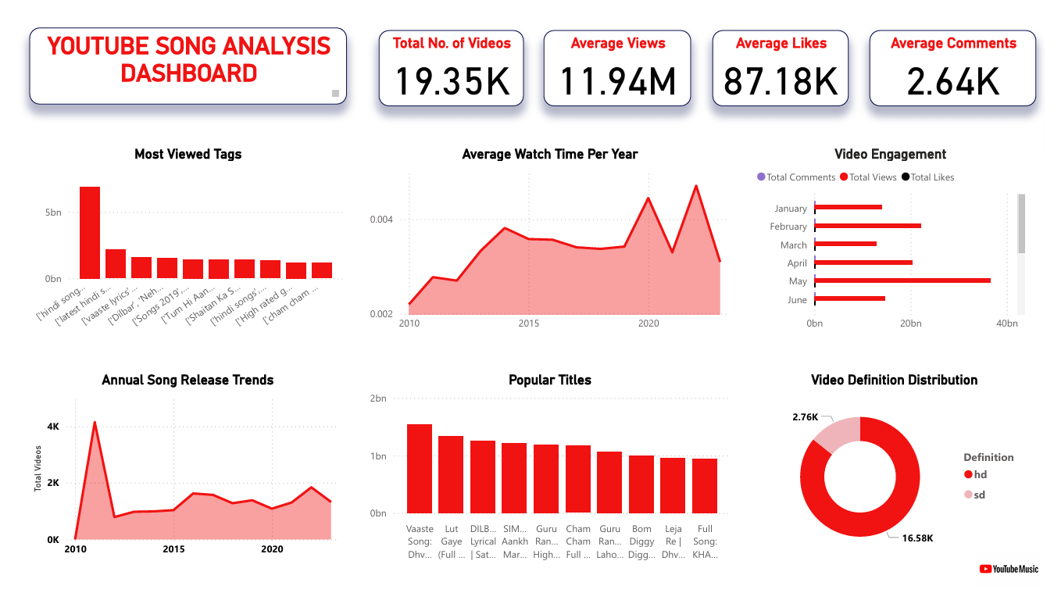
PowerBi Dashboard

Slide 8
What have we learned?
Peak publishing time is in May
Longer videos are more engaging
Creators should use more popular titles and tags
Viewers prefer HD videos

Slide 9
Conclusion
These conclusions provide insights into the characteristics of YouTube song videos, user engagement patterns, and factors influencing video performance. The findings can help content creators and marketers optimize their strategies for better visibility and engagement on YouTube.

Slide 10
Thanks!

